Slide 1


Mobile App Forensics
A forensic investigation of the Ride-hailing applications Taxi Stockholm and Sverigetaxi
Author: Gebrecherkos Abrha Halefom
Supervisor: Stefan Axelsson
Reviewer: Lars Asker
May 17, 2024

Slide 2
Table of content
Introduction
Problem statement
Research question
Extended background
The Taxi Stockholm and Sverigetaxi applications
Related work
Methodology
Forensic investigation
Results
Discussion
Conclusion
Limitations
Future research

Slide 3
Introduction
A ride-hailing app is a mobile application that allows users to book and pay for rides from nearby drivers using their smartphones.
Ride-hailing services are growing due to advances in ICT and the rise of the shared economy.
The global ride-sharing market is projected to grow significantly by 2028.
Ride-hailing apps collect extensive user data, raising privacy concerns.
Forensic investigations of these apps can help address related crimes.

Slide 4
Problem statement
Extensive sensitive information can be harvested from ride-hailing apps.
Current research on ride-hailing app forensics primarily focuses on privacy issues, neglecting comprehensive forensic analysis.
Need for comprehensive forensic research on ride-hailing applications.

Slide 5
Research question
What type of forensically relevant artifacts can be recovered from the ride-sharing mobile applications Taxi Stockholm and Sverigetaxi that could be relevant for forensic investigators?

Slide 6
Extended Background
Impact of Technology Revolution on Cybercrime
Growing Importance of Digital Evidence
Android Platform and Smartphone Forensics

Slide 7
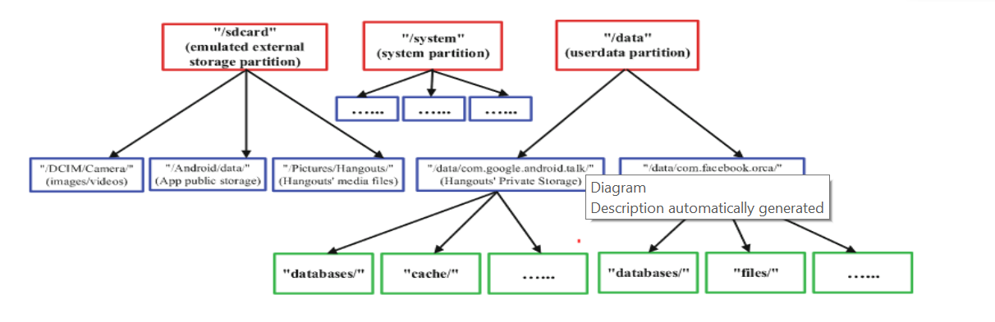
Android OS Platform Architecture & Storage Location
Android OS Components
Android Storage Locations

Slide 8
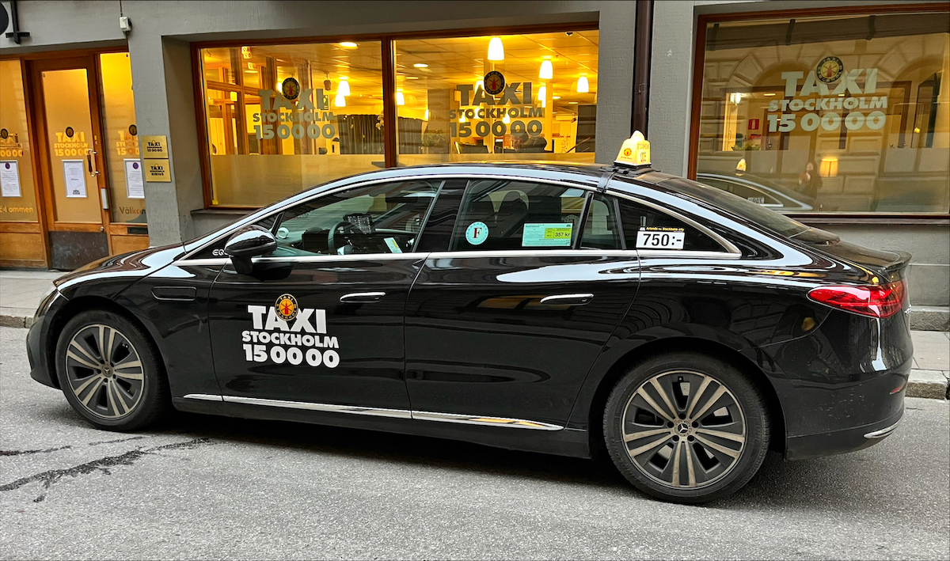
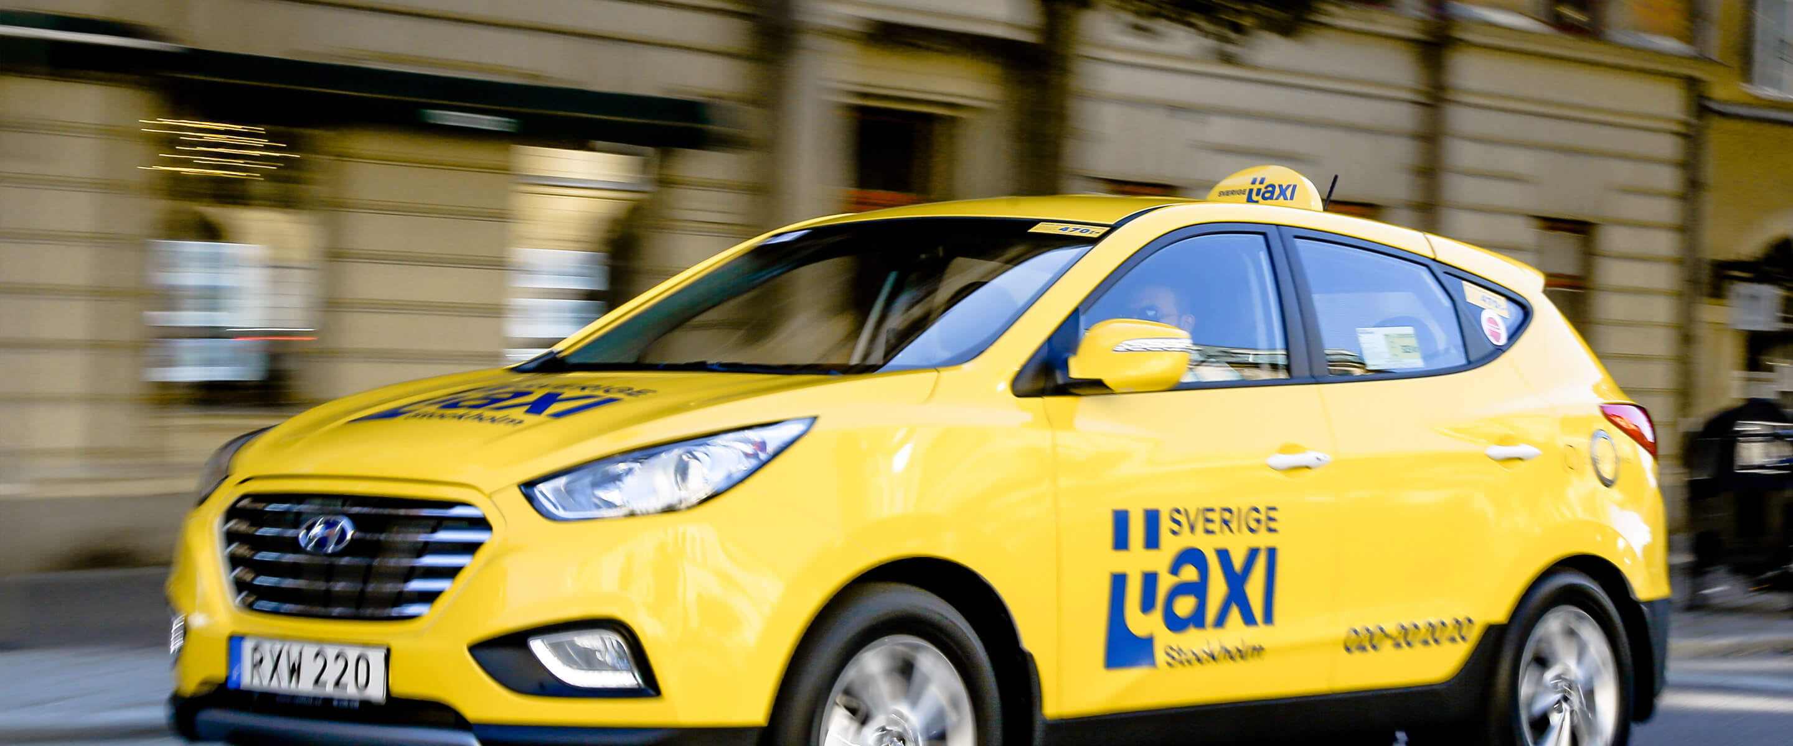
Taxi Stockholm and Sverigetaxi applications

Slide 9
Related work
Extraction of sensitive information from the Uber app, with a specific emphasis on the "nearby cars"(Zhao et al. 2019)
Uber app forensics primarily focuses on privacy concerns, suggesting ample opportunities for further forensic research (Darren R.et al. (2018).
Suggested for expanded digital forensics research on Android on-demand ride applications, highlighting emerging technologies like Uber Eats and Little coins for investigation (Kiptoo 2020).
Conducted a forensic investigation on third-party location sharing apps on iOS and Android devices, extracting evidence beneficial for investigations involving suspect location history (Bays and Karabiyik 2019)

Slide 10
Methodology
Research strategy: Case Study
Data collection: Systematic observations and data extraction from forensic tools
Data analysis: content analysis
Research Ethics

Slide 11
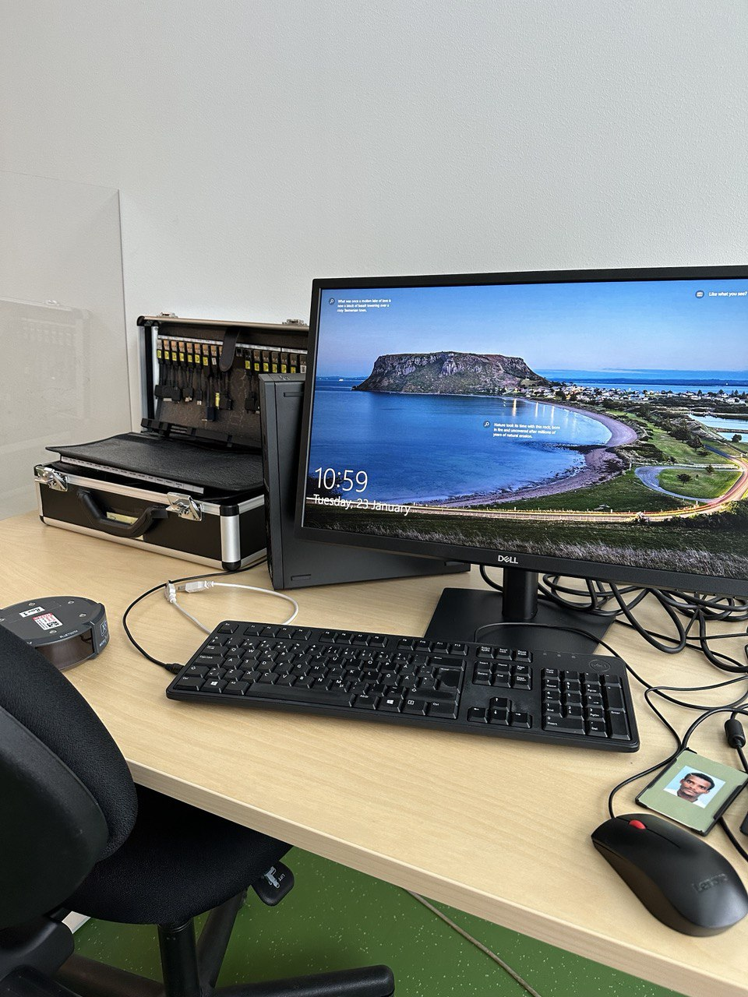
Forensic investigation

Slide 12
Preservation and investigation set up
email account was set up
Trips taken using both ride-hailing services
Automatic backup setup
Rooting
Device name | Model | Android version
Oneplus 5T | Oneplus A5010 | 10

Slide 13
Preservation and investigation set up …
Forensic tools used for backup and rooting | Usage | Versions
Google drive | Backup | -
PhoneTrans | backup | 5.0.1
Magisk | rooting | 27.0
TWRP For Oneplus 5T | Used for Installing custom ROMs | 3.5.1
Android Debug Bridge (Adb) | Enables Communication with Android devices from a computer over USB | 1.0.41
Fastboot | Flashing partitions, installing custom software on Android devices via USB | 34.0.4
Root checker | checks if an Android device has been rooted, confirming superuser access. | 6.5.3

Slide 14
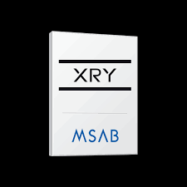
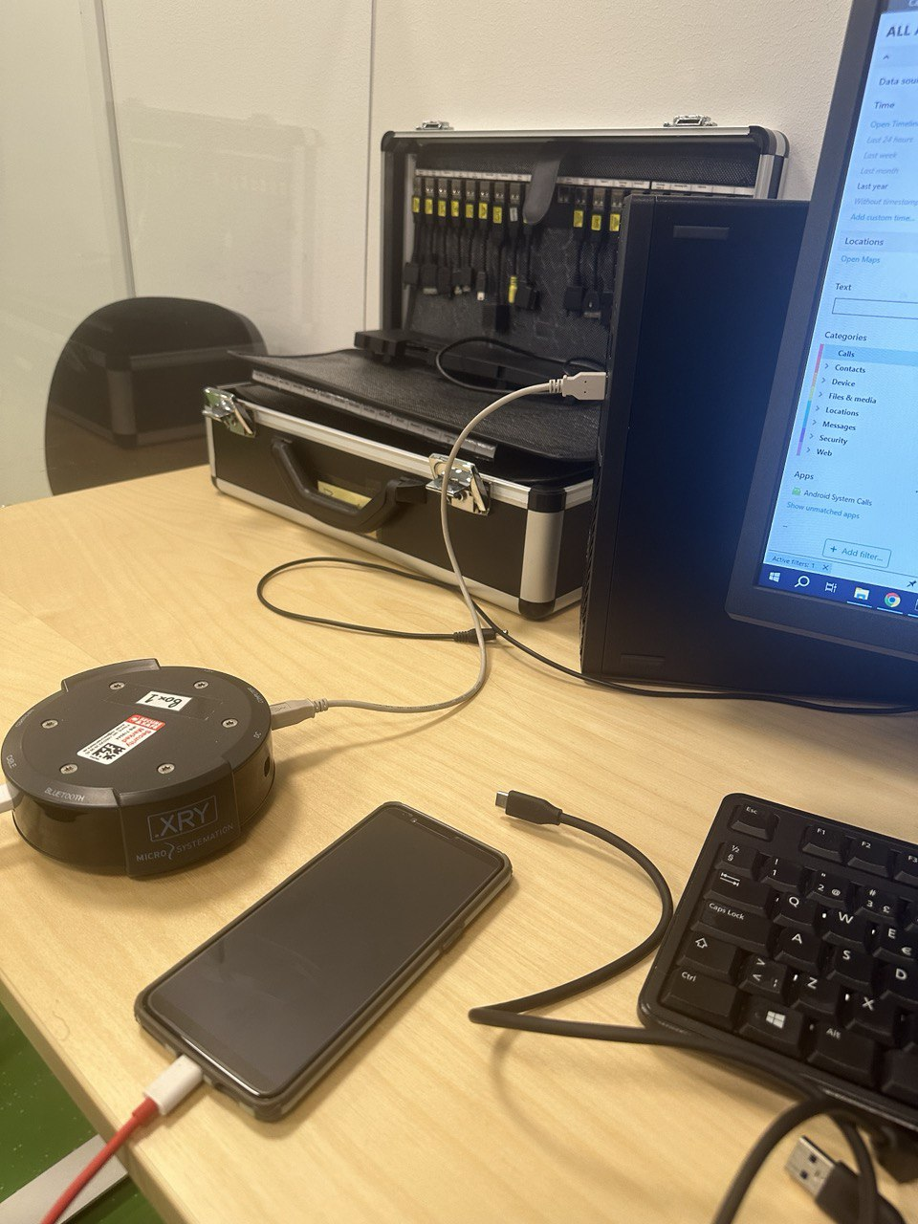
Forensic Data Acquisition

Slide 15
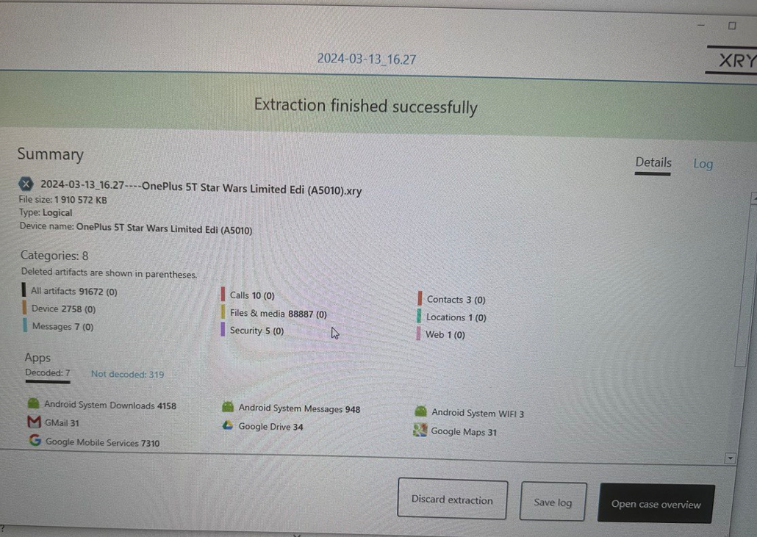
Forensic Data Acquisition …

Slide 16





Forensic Examination and Analysis

Slide 17
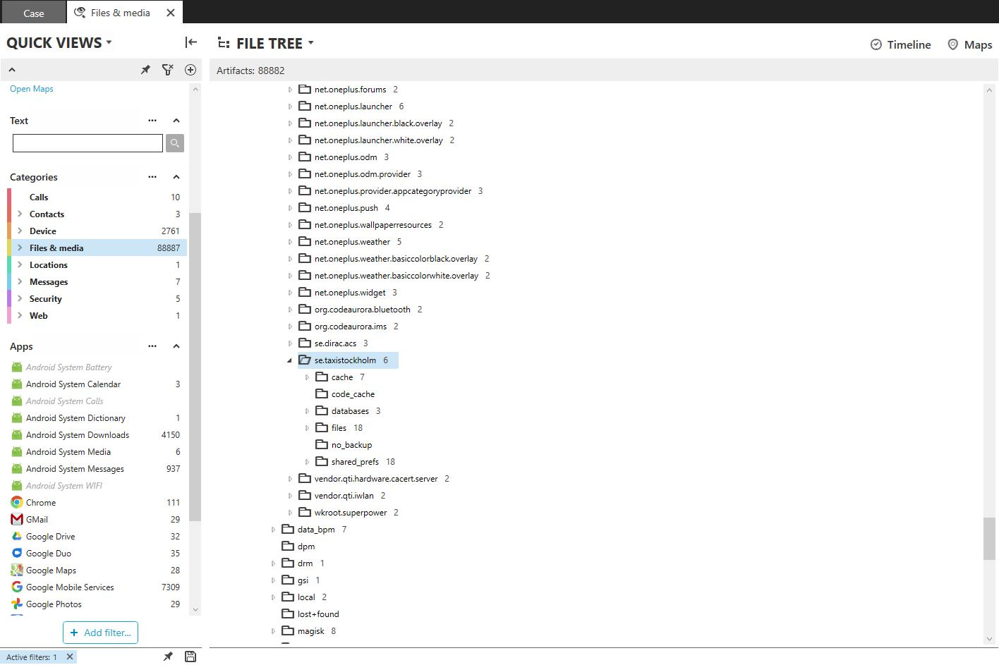
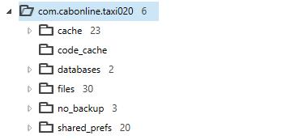
Forensic Examination and Analysis…

Slide 18
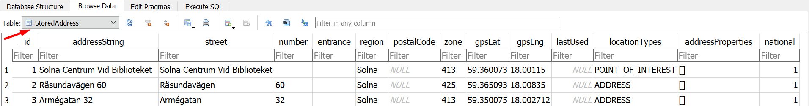
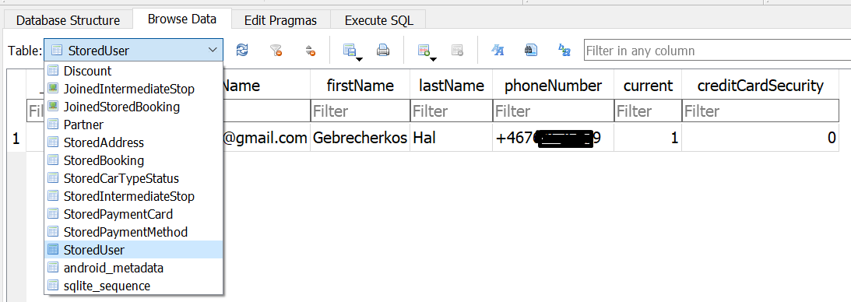
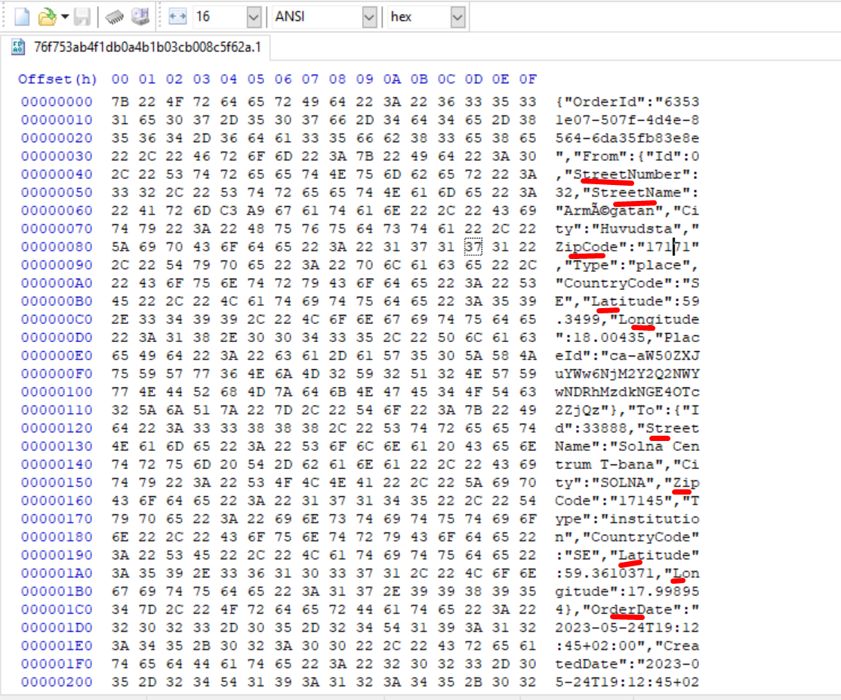
Results

Slide 19
Results …
Artifact | Taxi Stockholm | Sverige Taxi
Rider info (First Name, Last Name, Gmail Address, Phone Number) | ✓ | ✓
Company gmail Addresse | x | ✓
Company Support phone Number | x | ✓
Credit card details | ✓ | ✓
Trip payment invoice details | ✓ | ✓
Trip start and end address | ✓ | ✓
Vehicle number / VehicleId | ✓ | ✓
Vehicle plate number | ✓ | x
Driver Id | x | ✓
Vehicle (Registration Number, Manufacturer, Vehicle Model | x | ✓
Booking detalis | ✓ | ✓
Timestamps | ✓ | ✓
GPS Coordinates | ✓ | ✓
Continus Routes | x | ✓

Slide 20
Findings Themes and Patterns
rider Information
Company Information
Booking Details
Vehicle Information

Slide 21
Discussion: Analysis
Conducted digital forensic investigation of Taxi Stockholm and Sverigetaxi ride-hailing applications.
Successfully extracted various artifacts that can be relevant for legal proceedings and investigations.
Extracted artifacts include: Rider information (names, contact details, trip history), Credit card details, trip payment invoices, Timestamps, GPS coordinates
Reliability of GPS coordinates verified using Google Earth.
Timestamps converted to human-readable format using Python script.
SverigeTaxi yielded more artifacts compared to Taxi Stockholm.
Checksums calculated using SHA-256 hashing algorithm to maintain data integrity.
Research extended focus to all features of ride hailing applications, unlike previous studies by (Zhao et al., 2019), which focus on "nearby cars" feature of the app.

Slide 22
Conclusion
Research question answered.
Revealing sensitive information
Impact on the users, driver, ride hailing company
Replicating the forensic analysis in a real-world scenario is not feasible
contribute to the field of digital forensics

Slide 23
Limitations
Small-scale nature of the study, limited to individual user data.
Findings may not be generalizable to broader user population or other ride-hailing apps.
Constrained to Android ride-hailing applications, excluding iOS and other platforms.

Slide 24
Future Research
Potential areas for future research include broader range of ride-hailing applications and geographical locations.
Incorporation of data from multiple users to analyze wider range of interactions and behaviors.
Extension of focus beyond Android to include other mobile operating systems.

Slide 25


